Slide 1

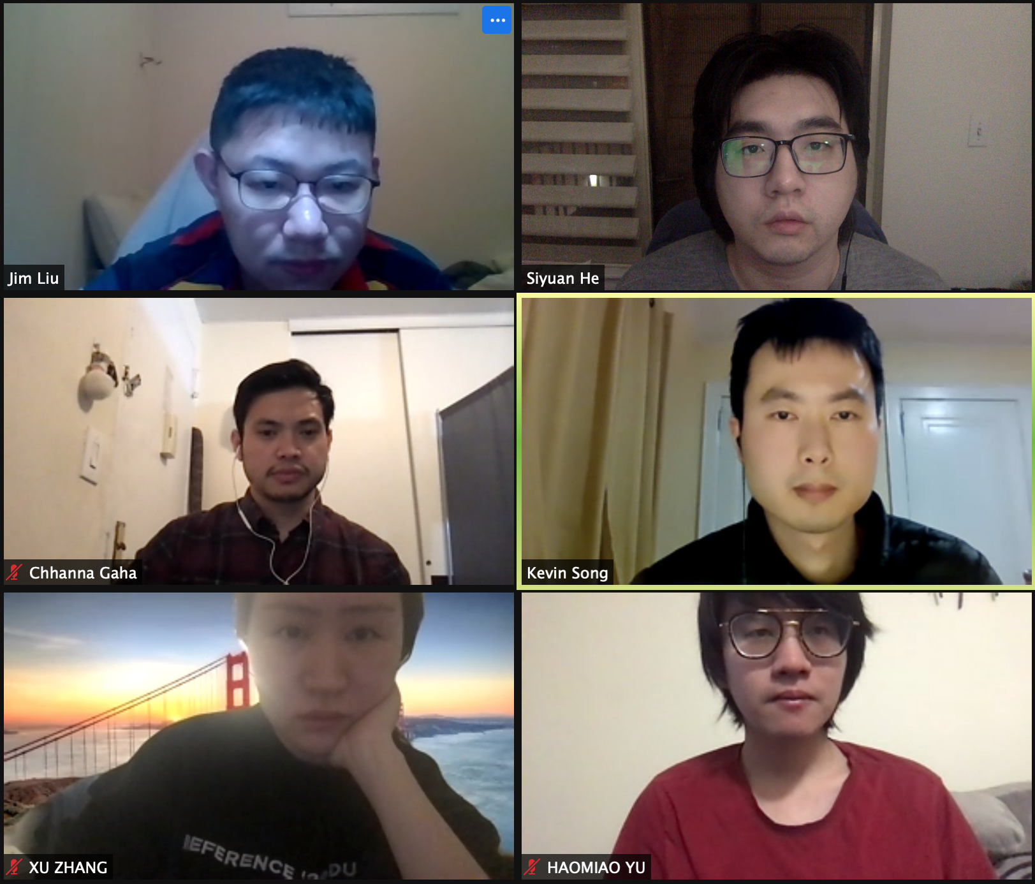
PC builder web application
Team member:
Kevin Song
Siyuan He
Xu Zhang
HaOmiao Yu
Chhanna Gaha
Sichao Liu
Guided By: Professor Henry Wong
Deliverable VIII
Team Name: Dice

Slide 2
TEAM ROLES
SiChao Liu | Product Owner | o Owns the Product backlog and writes user stories and acceptance criteria. o Ensures the accuracy of the code and debugging. o Enables close cooperation across all roles and functions.
Kevin Song | Scrum Master | o Holds every team meeting. o Maintains project’s GitHub and wiki. o Reviewed documents for grammar accuracy and assisted with debugging.
Chhanna Gaha | Team member/ Developer | o Maintains project’s Github and wiki. o Documented test cases and assisted with the design of database. o Helped product owner properly prioritize tasks.
Xu Zhang | Team member/ Developer | o Authored technical documentation. o Researched and Developed Personas in Product Design. o Managed burn down charts and forecasted project timeline.
HaoMiao Yu | Team member/ Developer | o Records the feedbacks from classes and put forward suggestions for improvements. o Authored technical documentation. o Served as the moderator for a retrospective session after a sprint.
SiYuan He | Team member/ Developer | o Made and combined every video for sprint presentations. o Designed PowerPoint for sprint presentations. o Designed product home page layout and assisted with back-end code.

Slide 3
Agenda
Project introduction
Persona
Technology we used
System Diagram
Data Model
Sprint 1-4 : MVP Overview and timeline (CS 691)
Sprint 5-7 : Sprints Recap (CS 692)
Sprint 8: Features
Retrospectives
Demo and links

Slide 4

Introduction
A new application is made if a developer produces a new idea or when there is new technology to create better software. Our team viewed many existing online PC hardware stores, realized that they are either created with older development tools or lacking modern functions that users need nowadays.
Therefore, we are here with a web application that is developed using React and other advanced technologies to achieve smooth browsing and satisfying functionality. The web app will help users select and purchase the right hardware for their requirements. Users can see what other users’ review for different builds to help them determine if they meet their needs.

Slide 5
Persona of a college Student
Hi, I am Nancy studying Bachelor's in Computer Science at North Georgia University. It’s difficult for me to pick a laptop out of many brands. There are ASUS, MSI, Dell and so many famous brands with similar hardware specs. I wish there was a good online application to help me identify which brand has the best hardware with the best price.

Slide 6
Persona of a software engineer
Hi, I am Jz Han. I am an experienced IT worker living in the Georgia suburb. In Georgia, the retail store is far away from where I live so I always shop for PC parts online. However, the websites that I am familiar with are only office related. They do sell PC hardware but it’s not their major business. I wish there was a web application that would just focus on selling PC parts. It would need to have a clear category breakdown and run smoothly just like any other shopping website.

Slide 7
Persona of a FilMmaker
Hi, my name is Mark. I’m an MFA of Filmmaking in the School of Visual Arts in New York. Next semester I will take classes related to video editing and color correction and I’m using 4K videos instead of 1080p videos. I’m changing my main editing tool from Adobe Premiere to Davinci Resolve. I have a great Gaming Desktop and it worked well with Premiere, but after moving to Davinci it runs much slower. I was told that I need a more powerful CPU to make the Davinci work perfectly. But the current processor manufacturers have made their product numbering too complicated, and it‘s hard for someone like me who lacks hardware knowledge to pick the processor I need. I hope there will be a website that could show me the configurations of different performance levels of computers where I could find the CPU I need and place an order directly on the website.

Slide 8
Persona of a Gamer
Hi, I am Jessi, a Bachelor at Pace University. I’m a big fan of AAA PC gaming so I plan to buy a powerful desktop which can be used for heavy gaming as well as course work. However, the gaming desktop currently on the market is usually more expensive, so building a desktop by myself will save money while having the same performance. But I don‘t know how to pick hardware, it’s too complicated for me. I wish there was a website that sold custom built desktops so I could get a desktop with great gaming performance at a relatively low price.

Slide 9
MVP
Which problem does it solve?
For the customers who are not familiar with the computer specs and components, it is difficult to choose the right PC builds or laptops that meet their needs.
Minimum:
A tool that helps customers build their own PC quickly and easily.
Viable:
A tool that helps customers set up their own PC quickly and easily. For customers without computer-related knowledge, it allows them to pick the right hardware for their needs. Customers can provide their working software information, budget, and expected years of use to get hardware recommendations. After selecting your PC build, you can either purchase the hardware directly from the website or pay a service fee and have it installed and delivered to you.
Minimum + Viable:
A tool that allows customers to select the right PC build for them while balancing budget and performance.

Slide 10




Technologies we used
React

Slide 11
Reasons we chose some of the technologies
React is an open-source, front end, JavaScript library for building user interfaces or UI components. The reusable components are suitable for our project.
MongoDB is a source-available cross-platform document-oriented database program. Classified as a NoSQL database program. We choose it as our database because it is fast and easy to use.
Node.js is primarily used for non-blocking, event-driven servers, due to its single-threaded nature. It is used for traditional web sites and back-end API services

Slide 12

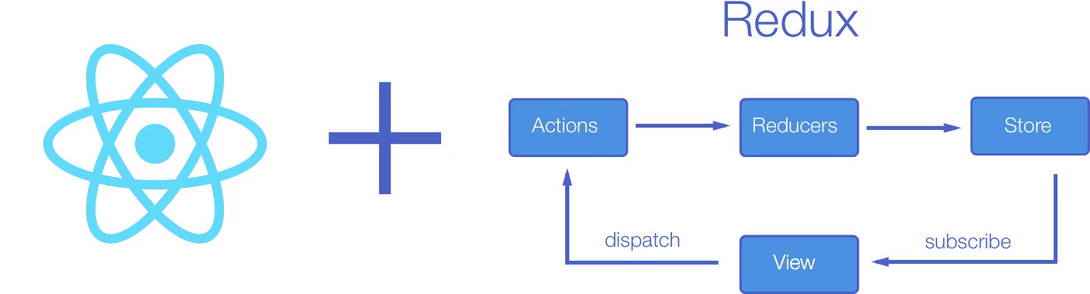
To Our Team:
Using redux with react allowed our team manage state of the app in one place and keep changes in our webapp more traceable. It makes it easier to know which change is made for what reason.
Redux is a predictable state container designed to help developer write JavaScript apps that behave consistently across client, server, and native environments and are easy to test.
It also made our web app’s code little bit more complex. However, we want our app ready for any future development

Slide 13
System Diagram

Slide 14
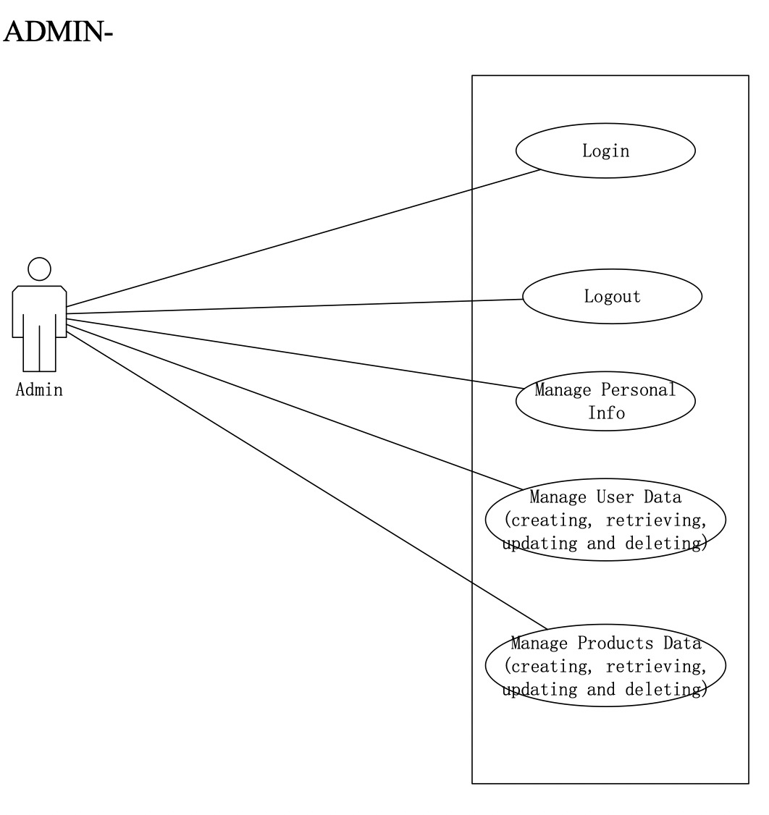
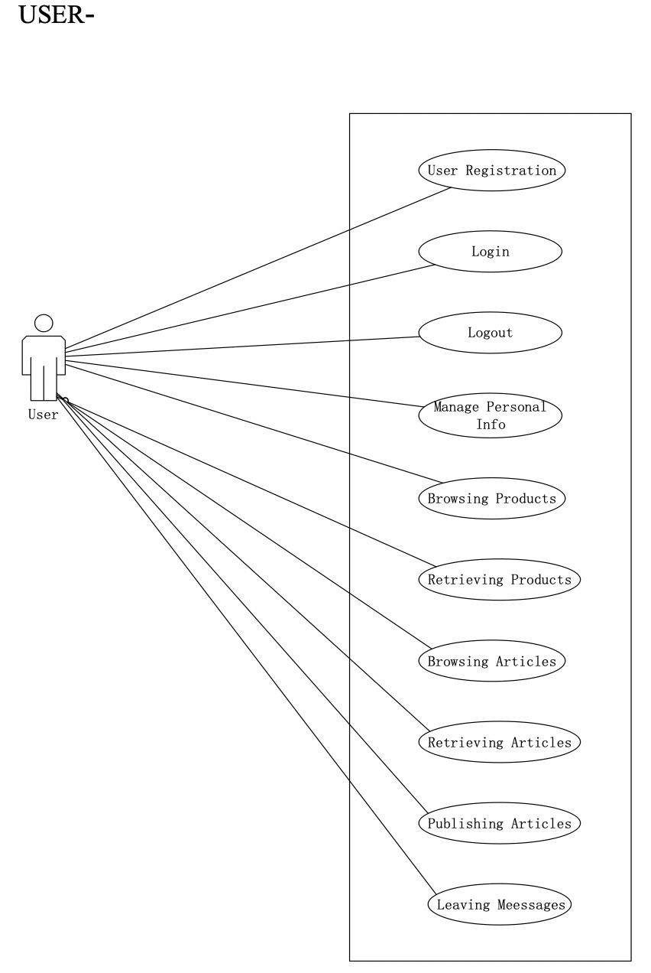

Slide 15
Data Model

Slide 16
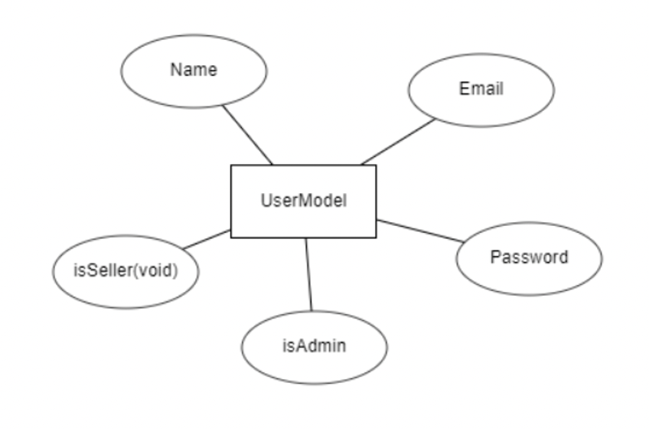
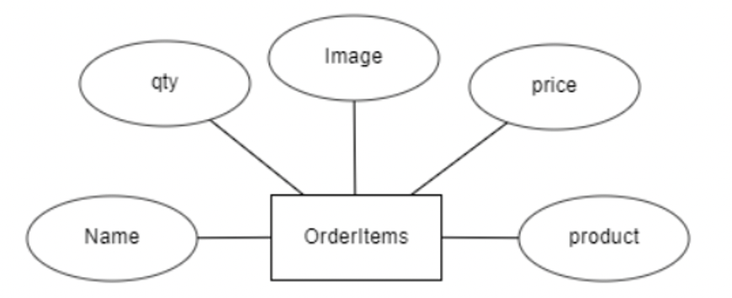
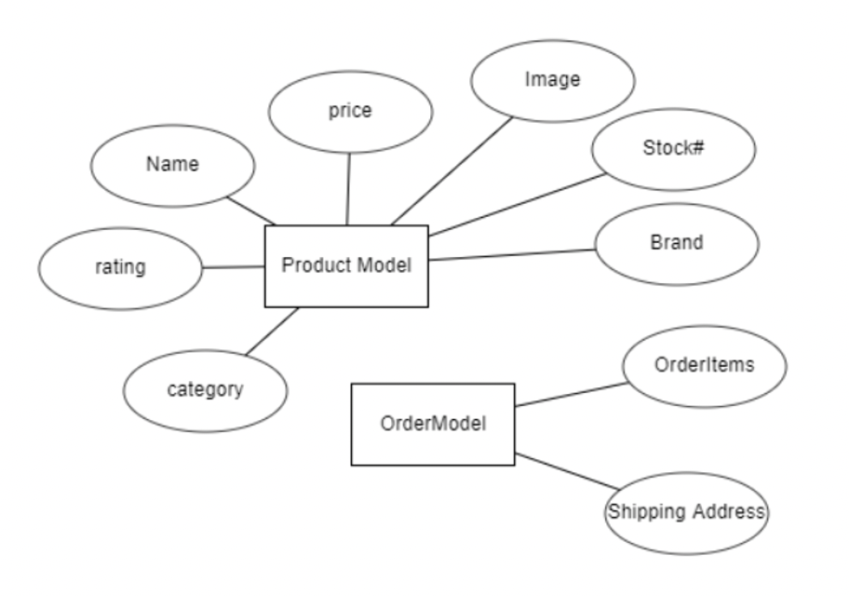
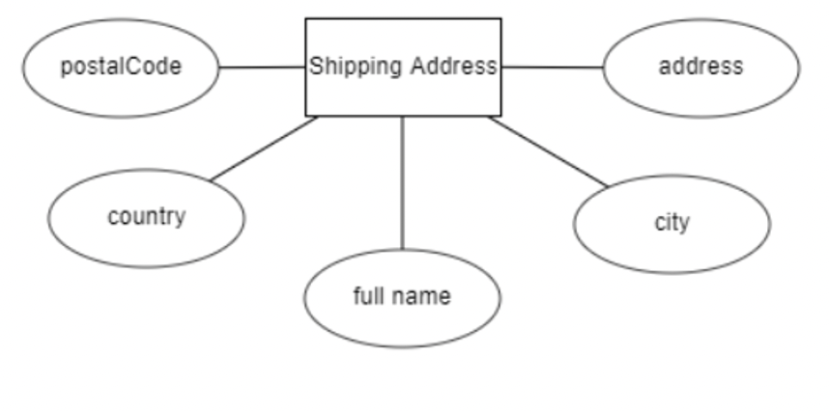

Slide 17

Sprint recap & Product Backlog Overview

Slide 18
Sprint 1-4 Recap

Slide 19
Sprint 1-4
MVP
Product Page
User can see product on the website
2. Shopping Cart
User can add items in the shopping cart
3. Log in
Users can login their account
4. Check out
Users can check out and mail the item to their address.

Slide 20
Sprint 1 Report
Type | ID | Summary | Reporter | Priority | Status
Task | 1 | Install development tools | Sichao Liu | High | Done
Task | 2 | Design website Template | Sichao Liu | Medium | Done
Task | 3 | Install communication platform | Kevin Song | Medium | Done
Sprint 2 Report
Type | ID | Summary | Reporter | Priority | Status
Task | 4 | Create website | Kevin Song | Medium | done
Task | 5 | Visualize Product Components | Chhanna Gaha | High | done
Task | 6 | Have detailed Product Page | Xu Zhang | Medium | done
Story | 7 | Have shopping cart | Xu Zhang | Medium | done

Slide 21
Sprint 3 Report
Type | ID | Summary | Reporter | Priority | Status
Story | 8 | Complete Register function | Chhana Gaha | Medium | done
Story | 9 | Login/logout function | Siyuan He | High | done
Task | 10 | Display added items on cart icon | Haomiao Yu | Medium | done
Task | 11 | Edit quantity in product and check out page | Xu Zhang | Medium | done
Sprint 4 Report
Type | ID | Summary | Reporter | Priority | Status
Task | 12 | Enter name and Shipping address in check out page | Siyuan He | High | Done
Task | 13 | Order number created after checking out | Haomiao Yu | Medium | Done
Story | 14 | Checkout function | Kevin Song | Medium | Done

Slide 22
Sprint 1-4 Committed vs Completed
Stories committed = 4
Stories completed = 4
Percentage of stories completed = 100%

Slide 23
Sprint 1-4 User Stories
ID | Feature | As a | I want to | So that I can
7 | Creating Shopping cart | User | Add the product in shopping cart | Keep the product I want to buy
8 | Register | User | Create an account on this website | Enjoy the service of the website
9 | Login/logout | User | Login to this website | Buy the things I want
14 | Check out | User | Check out the products I want to buy from the shopping cart. | Buy the products I want and mail to my address

Slide 24
Sprint 1-4 Acceptance Criteria
ID | Feature | Acceptance Criteria | Status
7 | Creating Shopping cart | User can add items to personal shopping cart page Added items should be saved to database | Pass
8 | Register | User can enter an email / password to a registration screen textbox Registration information should be saved to database | Pass
9 | Login/logout | Individual users or admins should be able to use previously registered info to login and logout of their specific account | Pass
14 | Check out | Items added to a user’s shopping cart can be purchased from a check out page Users should be able to enter shipping information Shipping information should be saved to database | Pass

Slide 25
Sprint 1-4 Test Cases
ID | Test Case | Steps | Expected Result | Actual Result | Status
7 | Creating Shopping cart | Click on add product to shopping cart | Item should be added to the user’s shopping cart | Item is added to the users shopping cart | Pass
 |  | Click on shopping cart button | User should be brought to the shopping cart page with added items | The shopping cart page is opened with the added items inside | Pass
8 | Register | Click register and input new account info on registration page | User should be able to click the register new user button to be brought to registration page to input account info | The registration page is opened with textboxes to input account info | Pass
 |  | See registered info saved to database | The newly registered account info is saved to the database | The new account info is shown in the database | Pass
9 | Login/logout | Enter user info on login page and click login button | User should be able to enter their account info to login as specific user or admin | The user or admin is logged in | Pass
 |  | Click logout button on homepage | User should be able to click the logout button to logout | The user or admin is logged out | Pass
14 | Check out | Click on checkout button from the shopping cart page | User should be taken to checkout page to fill in shipping info | The checkout page is open with textboxes to enter shipping info | Pass
 |  | Enter shipping info and click checkout button | User should be able to enter shipping info and click checkout button | The items are marked for shipping | Pass

Slide 26
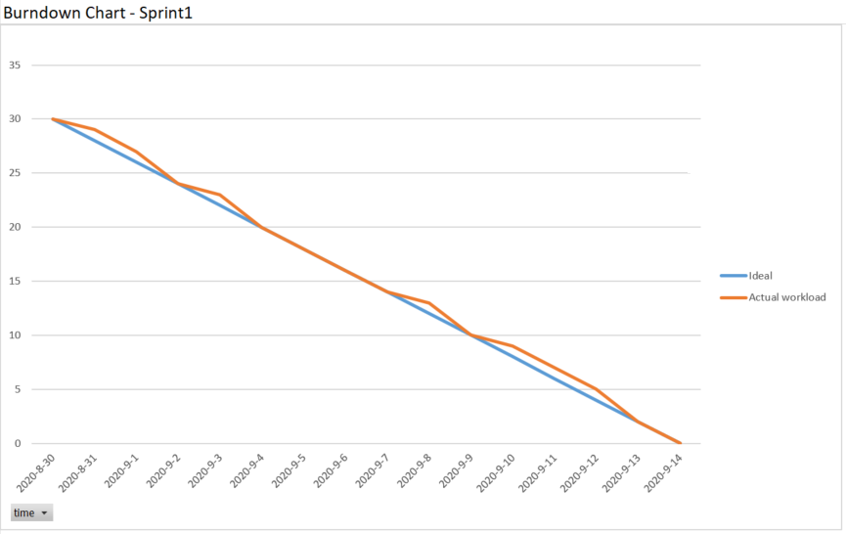
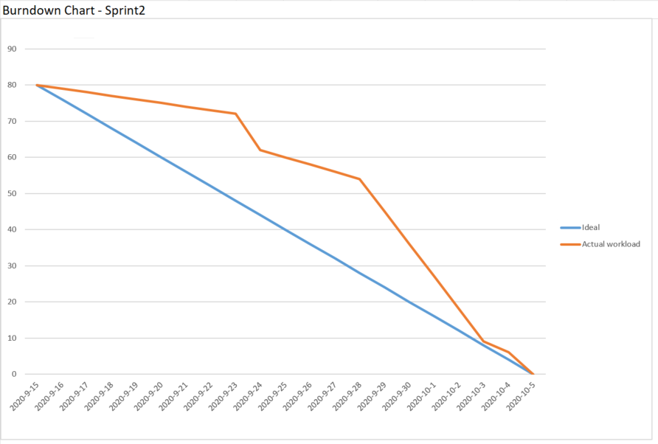
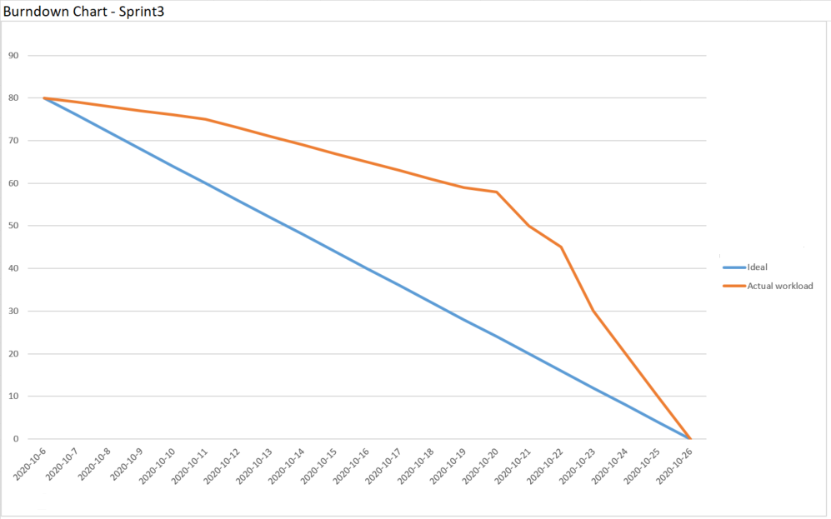
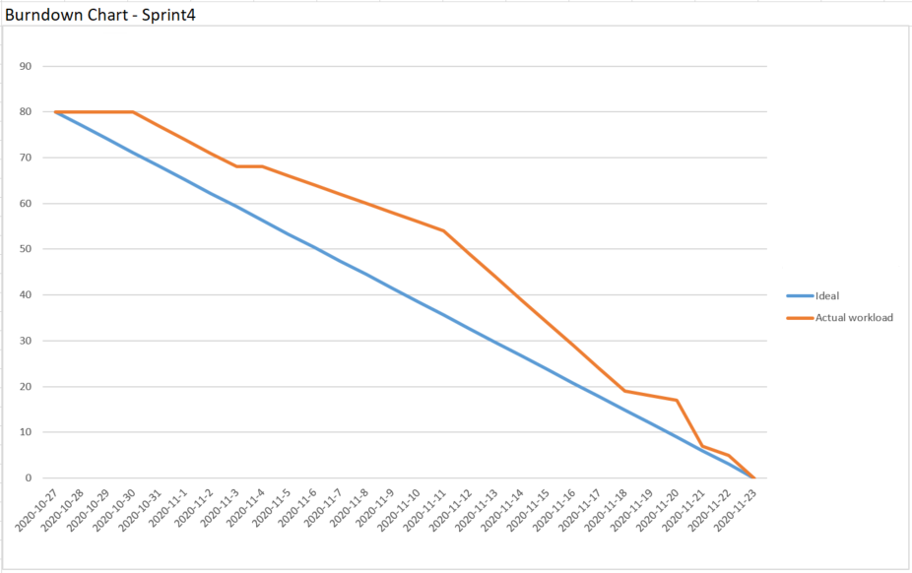
Sprint 1-Sprint 4: Burndown Charts

Slide 27
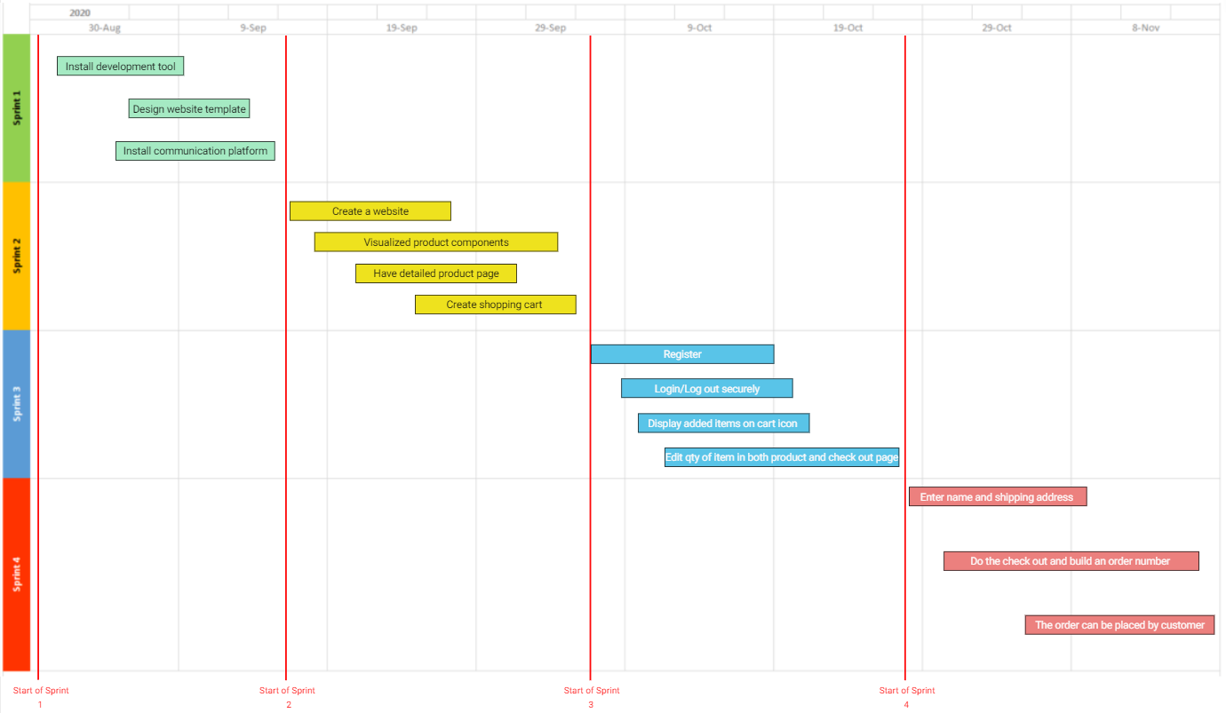
Sprint 1-Sprint 4: Feature Timeline

Slide 28
Sprint 5 Recap

Slide 29
Sprint 5
Sprint 5
We completed User Profile design including
Display User Profile
Create user details api
display user information
Update user profile’s Page
Create user update api
update user info (fail due to a database error)
Since the update function fail, our team met ¾ = 75% of the commitment.

Slide 30
Sprint 5 Backlog
Story ID | User type | I want be able to … | So that… | type | status
12 | User | Enter name and shipping address | I have name and shipping stored in profile | story | Done
13 | User | I want to check out and have an oder number | I can wait for my order | epic | Done
14 | Admin | I want to see order placed by customer | I can send order by shipping address | story | Done
15 | User | Have profile displayed | I can see my profile | story | Failed
16 | User | Update my profile info | I can freely edit profile and save | epic | In work
17 | Admin | List Product | I can see all order in list | story | Done

Slide 31
Sprint 5 : Committed vs Completed
# of Stories/tasks Committed = 4
# of Stories/tasks Completed = 3
% of Items Completed = 75%
Notes:
Priti

Slide 32
Sprint 5 Test Case
# | Process | Test Case | Description | Status | Expected Result | Actual result
15 | Profile displayed | Click on user profile button | Mouse hang on logged in user’s icon. | Passed | A drop-down menu show user profile pop up | The menu pop up with correct word
 |  |  | Move mouse to user profile button and click on it | passed | A form with user information showed up | A form with correct user information showed up
16 | Update Profile | Click on update button | In user profile page, fill in different user info and click update | Failed | User should have new info record in database and display correct name on icon | No data change
17 | List product | Click on List product button | Login as admin | passed | Current user should replace by admin user | Admin user successfully logged in.
 |  |  | Move mouse to admin icon | passed | A drop-down menu show List product showed up | The menu pop up with correct word
 |  |  | Move mouse to List product button and click on it | passed | A form shows all current order showed up | The form show up with correct information

Slide 33
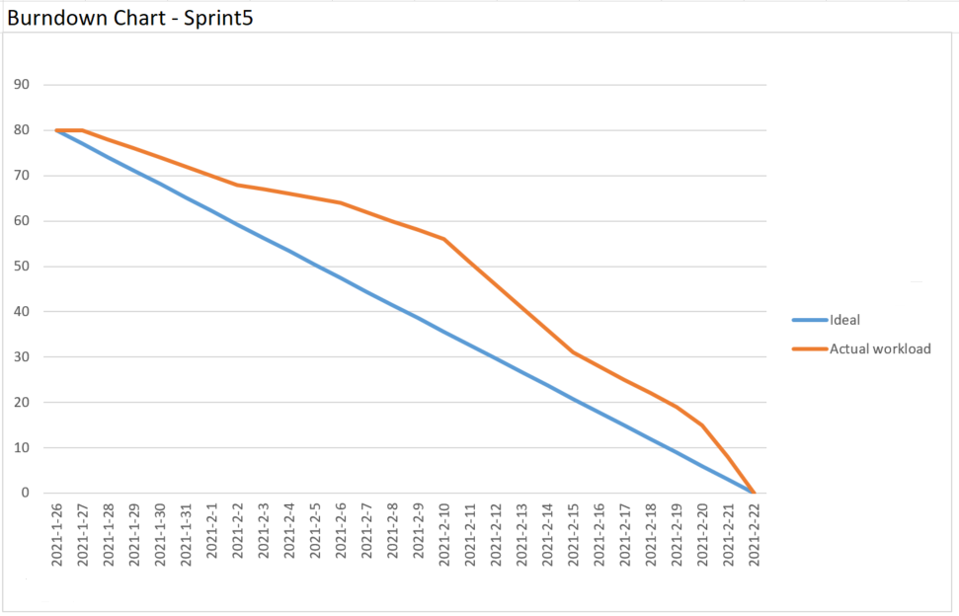
Sprint 5: Burndown Charts

Slide 34
Sprint 6 Recap

Slide 35
Sprint 6
We fix the “update user info” error from Sprint 5
We completed Admin product management view
List Product
Create product list screen
Display products form
Create Product
Build create product api
Finish the code for create product button
Build Product Edit Page
Create edit button and its page
Code function to load product details
Update Product (fail)- We managed to write the code for update product. However, it refuse to give desired result.

Slide 36
Sprint Backlog
Story ID | User Type | I want to be able to | So that… | Type | status
18 | Admin | Create product | I can create product on website | story | Done
19 | Admin | Update product | I can edit product info on website | story | skip

Slide 37
Sprint 6 : Committed vs Completed
# of Stories/tasks Committed = 4
# of Stories/tasks Completed = 3
% of Items Completed = 75%
Notes:
Priti

Slide 38
Sprint 6 Test Case
ID | Process | Test Case | Description | Status | Expected Result | Actual result
18 | Create Product | Click on Create Product Button | Login as admin | Passed | Current user should replace by admin user | Admin user successfully logged in.
 |  |  | Move mouse to admin icon and when drop down menu show up, click on products button | Passed | Products page showed up | Products page showed up
 |  |  | Click on Create product Button | Passed | A sample product added | Sample product successfully added.
16 | Update Profile | Click on update button | In user profile page, fill in different user info and click update | passed | User should have new info record in database and display correct name on icon | User profile successfully updated.
19 | Update Product | Click on edit Button in product page | Login as admin. Within the product page, click any product’s edit button | Fail | A form show up with correct product info, and admin can edit them. | Data base error _id undefined.

Slide 39
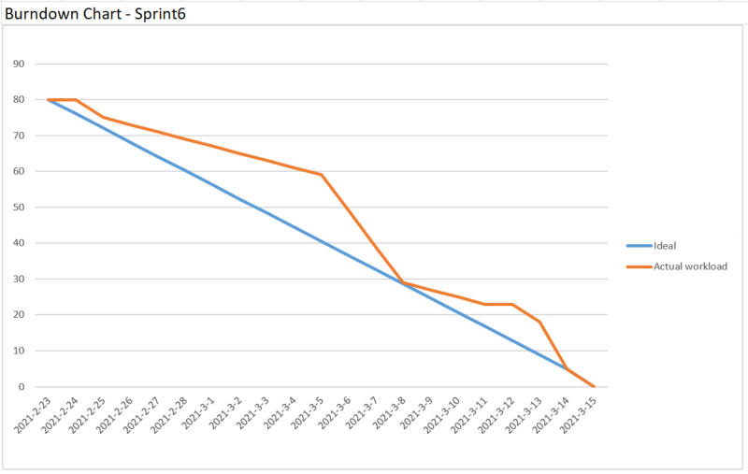
Sprint 6: Burndown Charts

Slide 40
Sprint 7 Recap

Slide 41
Sprint 7
The Database issue in SPRINT 6 remaining force the team to finish user management section in advance
We completed Admin’s User management ability with only the edit user function remaining
Code optimization is done so the deployment process can be easier.

Slide 42
Sprint Backlog
Story ID | User Type | I want to be able to | So that… | Type | status
20 | Admin | Update Product image | I don’t have to upload image manually | epic | skip
20a |  | Define upload router |  | task
20b |  | Create upload folder |  | task
20c |  | Edit code in frontend |  | task
21 | Admin | List users | I can list users | story | Done
22 | Admin | Delete users | I can remove unwanted user | story | Done

Slide 43
Sprint 7 : Committed vs Completed
# of Stories/tasks Committed = 3
# of Stories/tasks Completed = 2
% of Items Completed = 66%
Notes:
Priti

Slide 44
Sprint 7 Test Case
ID | Process | Test Case | Description | Status | Expected Result | Actual result
21 | List User | Click on Users Button | Login as admin | Passed | Current user should replace by admin user | Admin user successfully logged in
 |  |  | Move mouse to admin icon and when drop down menu show up, click on User button | Passed | User management page showed up | User List page showed up
 |  |  | Different user types are differentiated | Passed | In admin column, normal user marked as no while admin marked as yes | Normal user can not access user management ability. Normal user marked as no
22 | Delete User | Click on Delete button | The Admin User is specified and can not be delete | passed | Normal user will be removed while pop up shows for admin user prevent it from deletion | Delete for normal user success, admin user will not get delete
20c | Edit code in frontend |  | Patch up files and get ready for the final deploy |  | Some bugs were caught during the process | Several typos and css scaling issue has been fixed

Slide 45
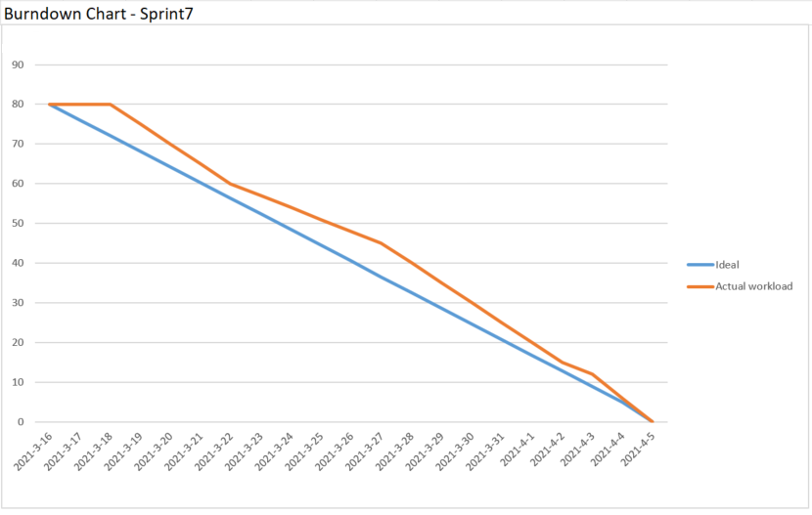
Sprint 7: Burndown Charts

Slide 46
Sprint 8

Slide 47
Sprint 8
The Edit User function carried over from sprint 7 was completed. So now an Admin can change a User’s info as needed.
Seller Page was not implemented. The story was skipped due to time constraints.
The deployment of the website was not carried out due to Heroku failure.
Our team completed 1 user story out of 3. ( 33% of the commitment )

Slide 48
Sprint Backlog
Story ID | User Type | I want to be able to | So that… | Type | status
23 | Admin | Edit user | I can’t change user’s info as needed | story | Done
23a |  | Build api for update users |  | task | Done
23b |  | Create edit screen UI |  | task | Done
24 | Seller | Have a seller page | I can list product for sale as a user | story | Skip
25 | Everyone | Deploy | Website is good to use | story | Fail

Slide 49
Sprint 8 : Committed vs Completed
# of Stories/tasks Committed = 3
# of Stories/tasks Completed = 1
% of Items Completed = 33%
Notes:
Priti

Slide 50
Sprint 8 Test Case
ID | Process | Test Case | Description | Status | Expected Result | Actual result
23 | Edit user | Click on edit button under user management | Login as admin and enter the user menu | Passed | Successfully sign in as admin and user menu is displayed after click | Admin user successfully logged in User Menu successfully displayed
 |  | Change username and password | Enter a different name and password for user and click save | Passed | The MongoDB’s data is updated with the entered data | The password and username successfully changed
 |  | Change a normal user to admin | In the admin selection window mark a normal user to admin | Passed | The user now become admin | The user now become admin and can access all admin function
25 | Deploy website | Update GitHub | Push all the change to GitHub and save | passed | Whole application updated to GitHub | GitHub repository have the newest version of app
 |  | Connect to mongo DB and Heroku | In MongoDB create a cluster and generate link and give Heroku the access link | Fail | The website successfully deployed and everything is now hosted on Heroku’s webiste | The Heroku refuse the link and the deployment failed

Slide 51
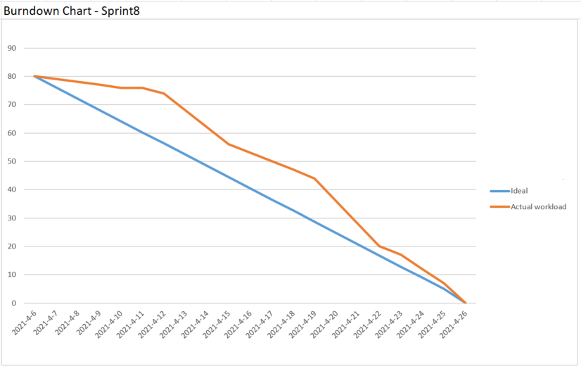
Sprint 8: Burndown Charts

Slide 52
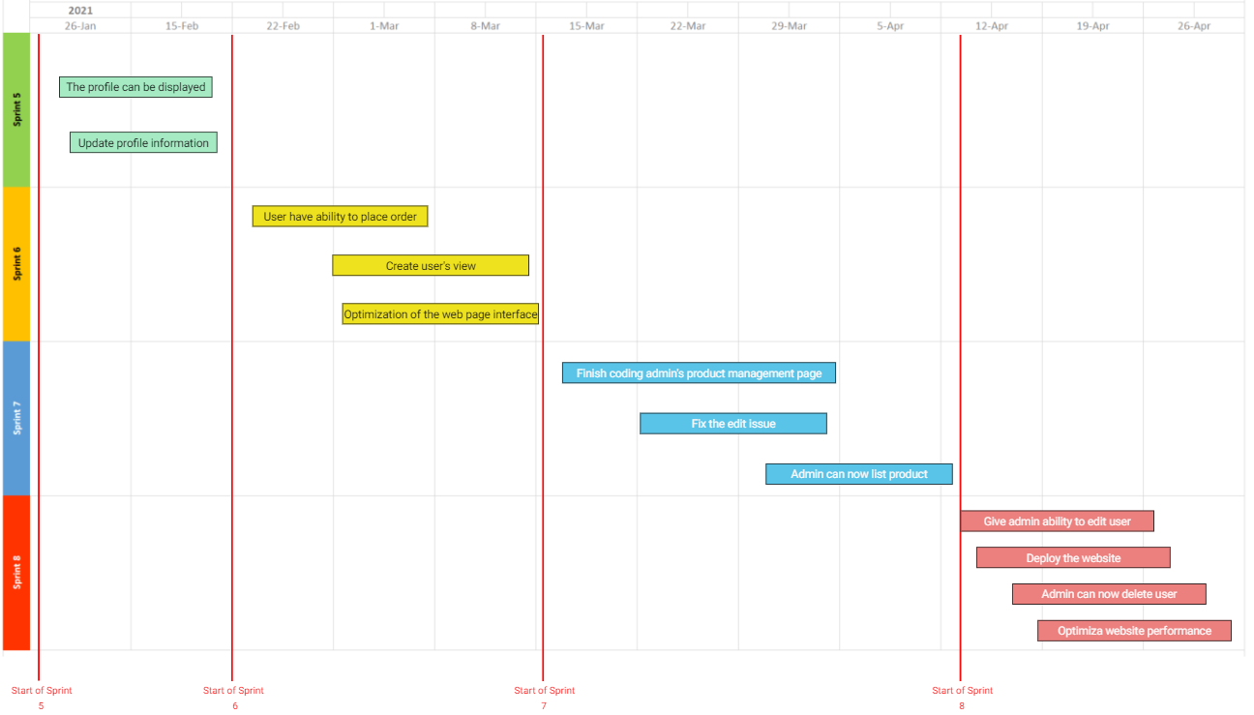
Sprint 5-Sprint 8: Feature Timeline

Slide 53
Retrospectives
What went well
-Communication among team members (5 votes)
-Team planning and participation (3 votes)
What needs improvement
-Logging work consistently (4 votes)
-Time management (3 votes)
Next step
- The best way to improve our time management is to log our daily activities. It will help eliminate focusing too much on less important task so that we can become more productive. (4 votes)

Slide 54

GitHub link
https://github.com/ksong227/CS691TeamDice
Thank You

